Slide 1

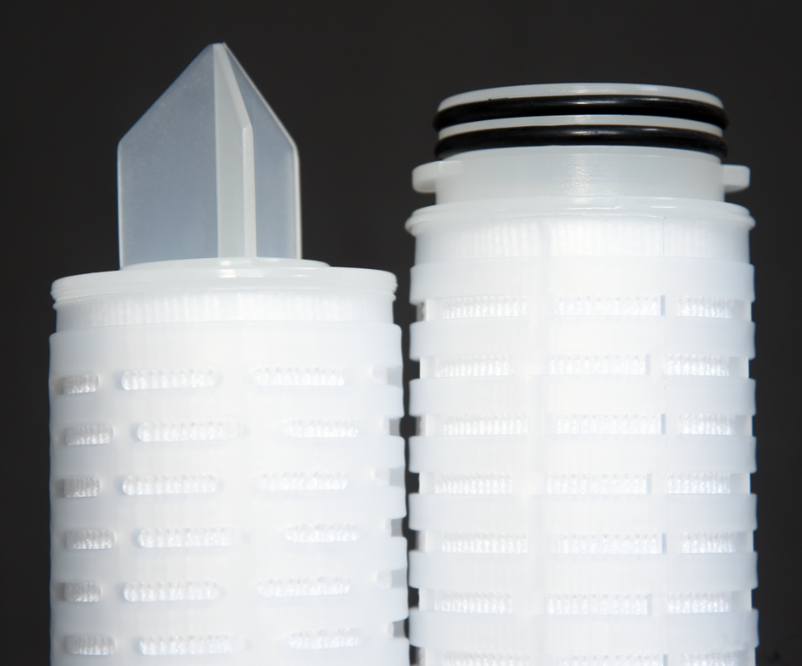
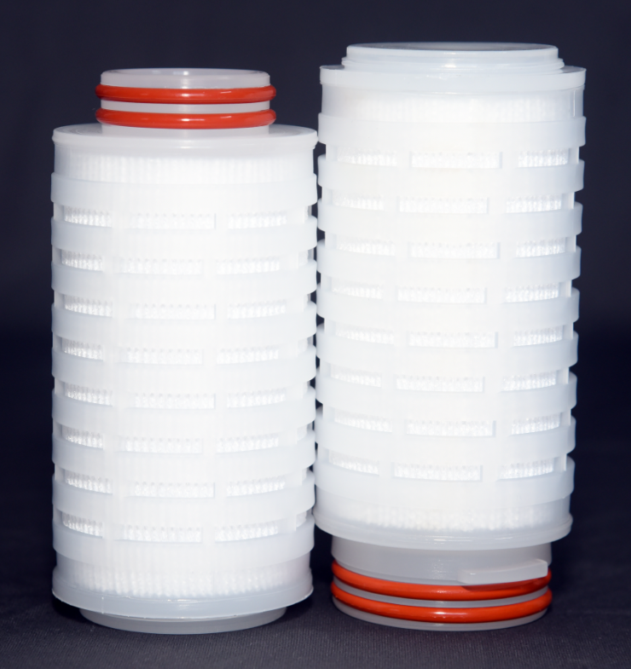
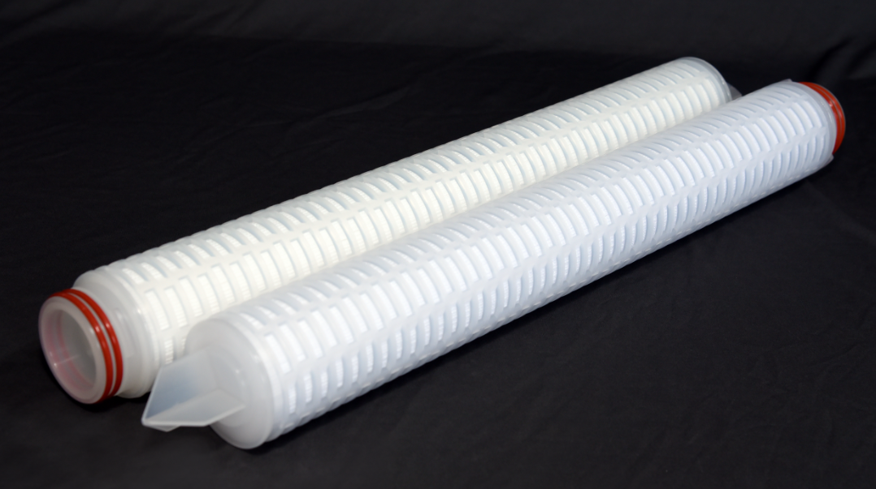
KGT POLYPRO FILTER
ABOUT
The KGT Polypro Cartridge filter has absolute removal rating enabling removal of contaminations with consistent efficiency for critical applications, with option of nominal ratings for less critical applications like prefiltration.
Apart from the wide chemical compatibility, the filters are suitable for either high flow rate or high viscous liquid, having a high dirt holding capacity.
The KGT Polypro cartridge filter is available in various removal ratings enabling it to handle a wide range of fluids with a considerable dirt holding capacity.
ADVANTAGES
Due to wide range of pore size selection, a variety of liquids from acids to alkalis; from seawater to process water; and lube oils to petroleum fluid.
Standard dimensions ensures fitment in most standard housings with varied length availability. (other dimensions available on request)
Available in 2.5, 5, 10, 20, 30, 40 inch lengths (Other lengths available on request.)
All materials of construction are available in 21CFR Compliant materials and have passed as per USP class VI Biological tests for plastics @ 121°C.
Available in both absolute and nominal ratings
DIFFERENCIAL PRESSURE DATA
For Normal Flow from Outside to Inside for liquids compatible with the filter media, the maximum differential pressure is
Polypropylene Medium: 3.4 bar d @ 25 ⁰C
2.0 bar d @80⁰C
APPLICATIONS
Electronics Pharmaceuticals
Food & Beverages Oil & Gas
Power Generation Process & Waste Water

Slide 2
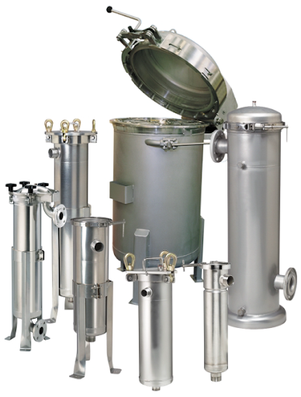
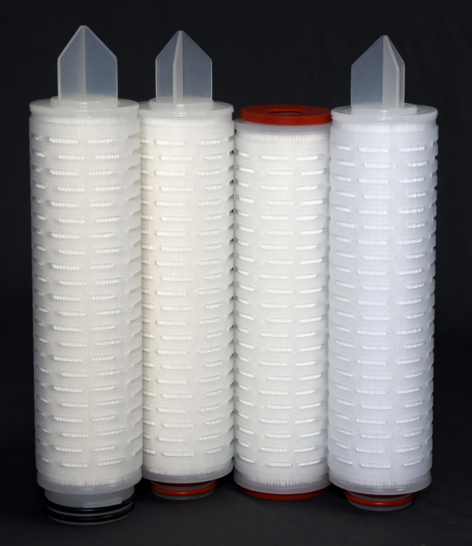
KGT POLYPRO FILTER
PART NUMBERING GUIDE
Filter Element Part Number : KGT - PP - - - - -
Short Code Removal Rating (µm) Short Code Removal Rating (µm)
002 0.2 050 05
005 0.5 100 10
010 01 200 20
020 02 400 40
Short Code Length (inches) Short Code Description
05 5 N Nominal
10 10 A Absolute
20 20
30 30
40 40
Short Code End Connection Short Code Seal Material
7 226 O-ring with Fin V Viton® A
8 222 O-ring with Fin S Silicon
0 Double Open End F PTFE (Gasket) / FEP (O-ring)
N Nitrile
Viton® is a registered trademark of Chemours Company.
 6, Anurag, Rajaji Path, Ramnagar, Dombivli, Mumbai, 421201, Maharashtra, India
 +91 251 2420878  +91 9166 593 315  solutions@klengas.com

